Slide 1
Employee Data Analysis using Excel
STUDENT NAME:K.GAYATHRI
REGISTER NO:312204179
NM ID; 633E0C5FF23CCC3B14D4421EFC5EBCC7
DEPARTMENT:B.COM(GENERAL)
COLLEGE:C.S.I EWART WOMEN’S CHRISTIAN COLLEGE.

Slide 2
PROJECT TITLE
Employee Performance Analysis using Excel

Slide 3


AGENDA
Problem Statement
Project Overview
End Users
Our Solution and Proposition
Dataset Description
Modelling Approach
Results and Discussion
Conclusion
3/21/2024 Annual Review

Slide 4

PROBLEM STATEMENT
Basic Excel functions may not fully support advanced performance analysis.
Need for complex formulas or additional tools for in-depth analysis.

Slide 5

PROJECT OVERVIEW
Implement charts and graphs to visualize performance trends.
.

Slide 6

WHO ARE THE END USERS?
HR professionals
Employees
Managers and supervisors.

Slide 7

OUR SOLUTION AND ITS VALUE PROPOSITION
.conditional Formatting –missing
.Filter –remove
.Formula-performance
. Pivot-summary
. Graph-Data visualization

Slide 8
Dataset Description
. Employee dataset-kaggle
.26 features
. Features -9 features
. Employee ID
.Gender-male,female
. Performance
. Business Unit
.First Name
.Last Name
. Employee rating
. Employee timing –full time or contact

Slide 9

THE "WOW" IN OUR SOLUTION
. Performance level formula
. =IFS(Z2>=5,”very high,”Z2>=3,’’MED”,TRUE,”LOW’’)
3/21/2024 Annual Review
9

Slide 10
MODELLING
Visualization
Formulas
Data collection
10

Slide 11
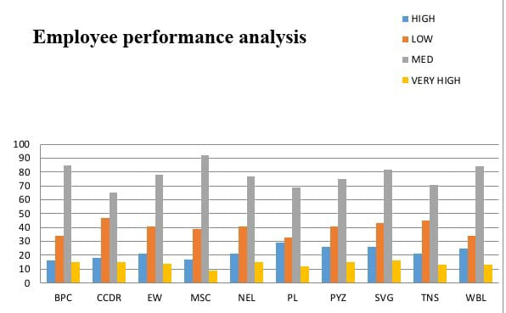
RESULTS
11

Slide 12
conclusion
The conclusion section of an employee performance analysis using Excel should summarize the key insights, evaluate the effectiveness of the analysis, and provide a clear path forward.

